Slide 1
NXP Development Platform Data for MakeNTU 2026
Update by March 13, 2026

Slide 2
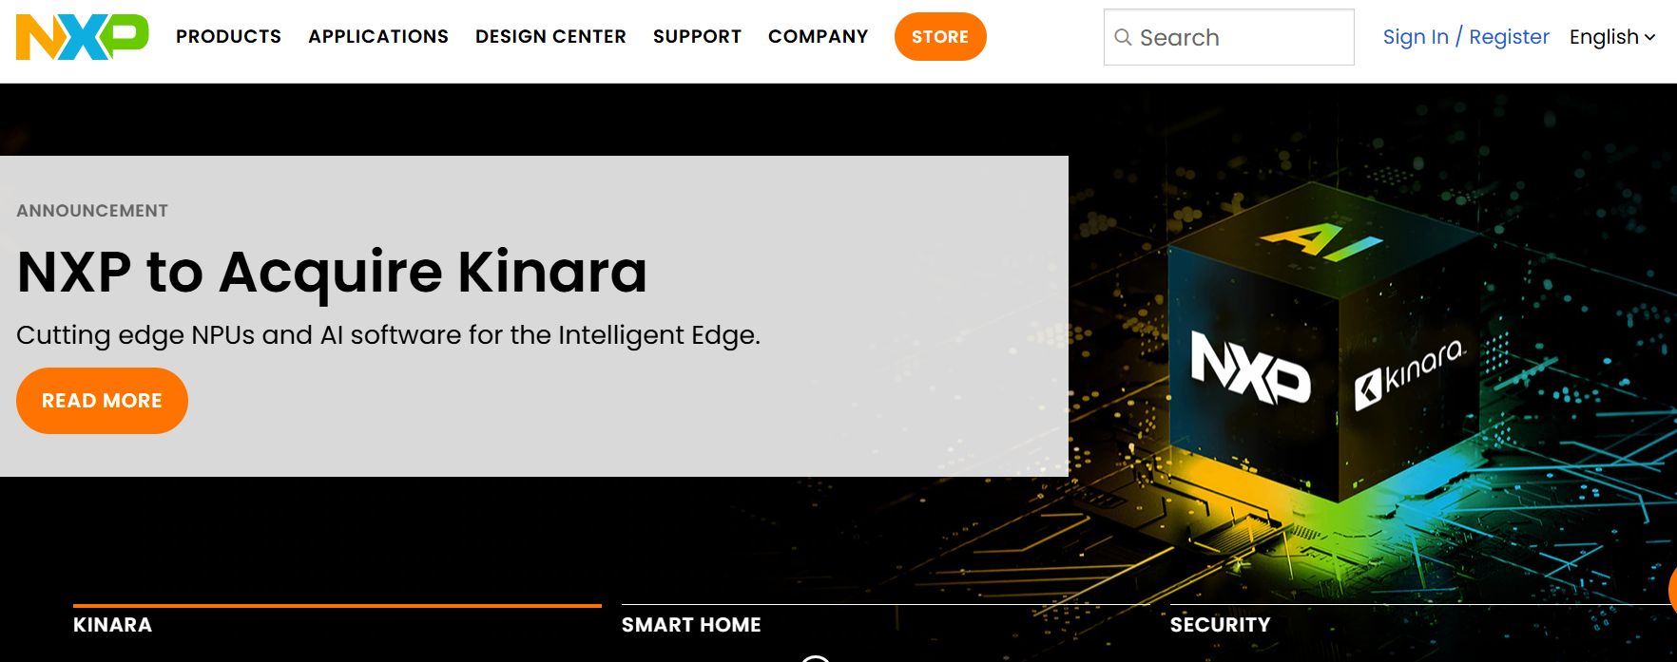
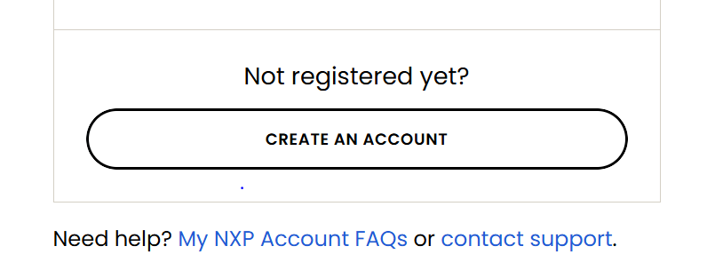
Important Reminder: Apply NXP Account 申請帳號 – 以郵件信箱申請
Step 1: NXP 官網 https://www.nxp.com/
Step 2: 點擊Sign In/Register
Step 3:Create Accunt https://www.nxp.com/security/login?TARGET=https%3A%2F%2Fwww.nxp.com%2F
Email is required

Slide 3
Tooling & Training materials download link:
https://drive.google.com/drive/folders/1bdupMNYFyNgSO0oJRCgWrjLL3mOfAdEk?usp=sharing

